Slide 1
IC Fabrication & Stuffing
Presented to: Muntizer Hussain

Slide 2
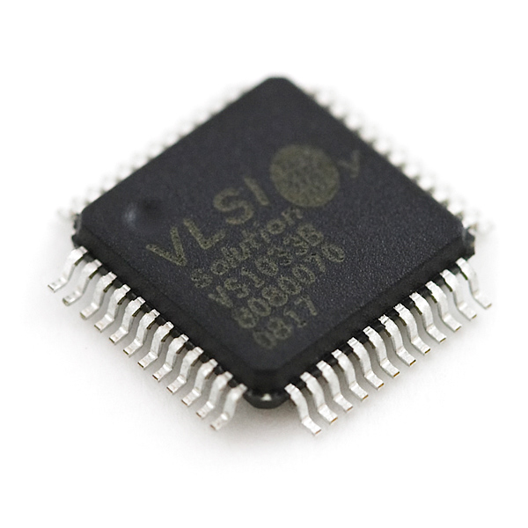
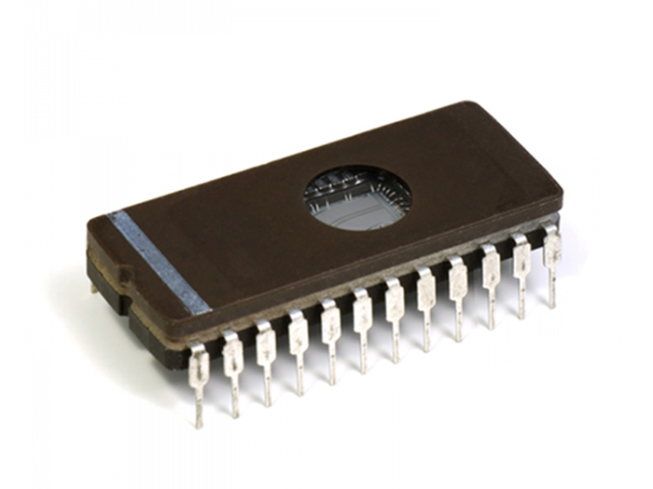
INTEGRATED CIRCUIT
An Integrated Circuit (IC) is also called as chip or microchip. It is a semiconductor wafer in which millions of components are fabricated. The active and passive components such as resistors, diodes, transistors etc and external connections are usually fabricated in on extremely tiny single chip of silicon.

Slide 3
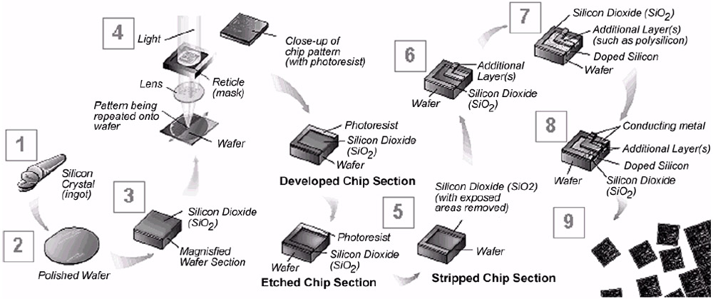

Slide 4
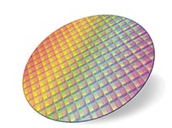
Step 1: Wafer production
The first step is wafer production. The wafer is a round slice of semiconductor material such as silicon. Silicon is preferred due to its characteristics. It is more suitable for manufacturing IC.
First purified polycrystalline silicon is created from the sand.
Then it is heated to produce molten liquid.
A small piece of solid silicon is dipped on the molten liquid.
Then the solid silicon (seed) is slowly pulled from the melt.
The liquid cools to form single crystal ingot.
Each slice having thickness about .01 to .025inches

Slide 6
Step 2: Masking
To protect some area of wafer when working on another area, a process called photolithography is used.
The process of photolithography includes masking with a photographic mask and photo etching. A photoresist film is applied on the wafer. The wafer is aligned to a mask using photo aligner. Then it is exposed to ultraviolet light through mask.
Before that the wafer must be aligned with the mask. Generally, there are automatic tools for alignment purpose.

Slide 8
Step 3: Etching
It removes material selectively from the surface of wafer to create patterns. The pattern is defined by etching mask. The parts of material are protected by this etching mask. Either wet (chemical) or dry (physical) etching can be used to remove the unmasked material. To perform etching in all directions at same time, isotropic etching will be used.

Slide 10
Step 4: Doping
Diffusion is defined as the movement of impurity atoms in semiconductor material at high temperature.
Atomic diffusion:
In this method p and n regions are created by adding dopants into the wafer. The wafers are placed in an oven which is made up of quartz and it is surrounded with heating elements. Then the wafers are heated at a temperature of about 1500-2200°F.
Ion implantation

Slide 12
Step 5: Metallization
It is used to create contact with silicon and to make interconnections on chip. A thin layer of aluminium is deposited over the whole wafer. Aluminium is selected because it is a good conductor, has good mechanical bond with silicon, forms low resistance contact and it can be applied and patterned with single deposition and etching process.
Assembly and packaging
Each of the wafers contains hundreds of chips. These chips are separated and packaged by a method called scribing and cleaving. The wafer is similar to a piece of glass. A diamond saw cut the wafer into single chips.

Slide 13
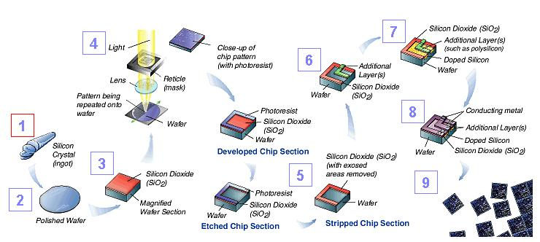

Slide 14
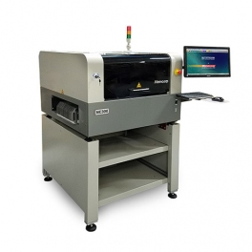
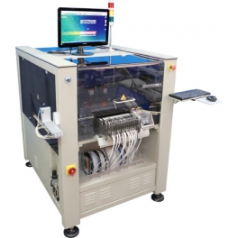
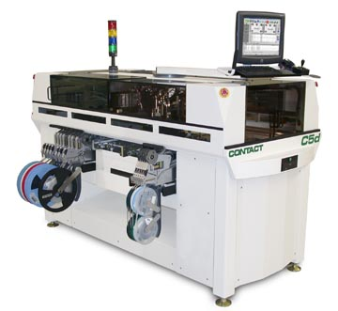
PCB Assembly Using Pick & Place or PCB Stuffing
SMD Pick and Drop Machine

Slide 15
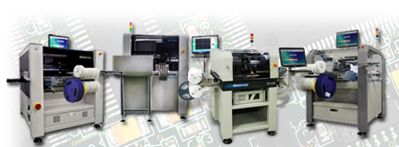
SMT Machine:
SMT (surface mount technology) component placement systems, commonly called pick-and-place machines or P&Ps, are robotic machines which are used to place surface-mount devices (SMDs) onto a printed circuit board (PCB).

Slide 16
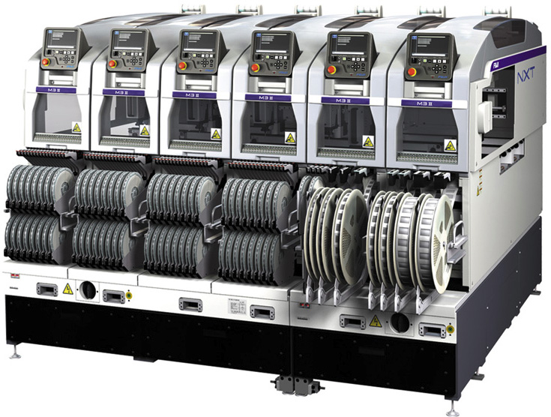
SMT Components Disk:

Slide 17
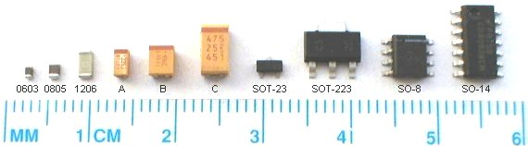
SMD Devices
An electronic device so made is called a surface mount device (SMD). In the industry it has largely replaced the through - hole technology construction method of fitting components with wire leads into holes in the circuit board.

Slide 18
PROCESSES INVOLVED
SURFACE MOUNT DESIGN
SOLDER PASTE APPLICATION
COMPONENT PLACEMENT
SOLDERING
CLEANING
REPAIR/REWORK

